Slide 1
Engineering and Operations Management Lunch & Learn Webinar Series
November 11, 2020

Slide 2
Please save all questions until the end of the presentation.
Please do not use the “Raise Hand” feature in this session.
We ask all questions will be typed in the Chat Box at the end of the presentation.
THANK YOU!
LET’S GET STARTED!
Notes:
Slide

Slide 3

College of Engineering & Industrial Engineering Programs
Master of Science
Operations Management
Engineering Management
Engineering
Graduate Certificates
Project Management
Lean Six Sigma
Homeland Security

Slide 4

Today’s Presenter
Walt DeGrange
Sports Analytics: Putting the Fun Back Into Analytics
Walt DeGrange is the Director for Analytics Capability for CANA Advisors where he helps organizations use analytics across federal and commercial domains. Prior to CANA Advisors, he had 21 years of Naval service as a Supply Corps Officer. The last 10 years in the Navy, his positions focused on supply chain analytics. He has taught courses in the MSOM program since 2014. Prior to that, he was an Assistant Military Professor at the Naval Postgraduate School in the Operations Research Department. Walt has also served on the Military Operations Research Society (MORS) Board of Directors and as the Chairperson for the INFORMS SpORts Section.

Slide 5
Charles Barkley (2015)
"Analytics don't work at all. It's just some crap that people who were really smart made up to try to get in the game because they had no talent. Because they had no talent to be able to play, so smart guys wanted to fit in, so they made up a term called analytics. Analytics don't work.”

Slide 6
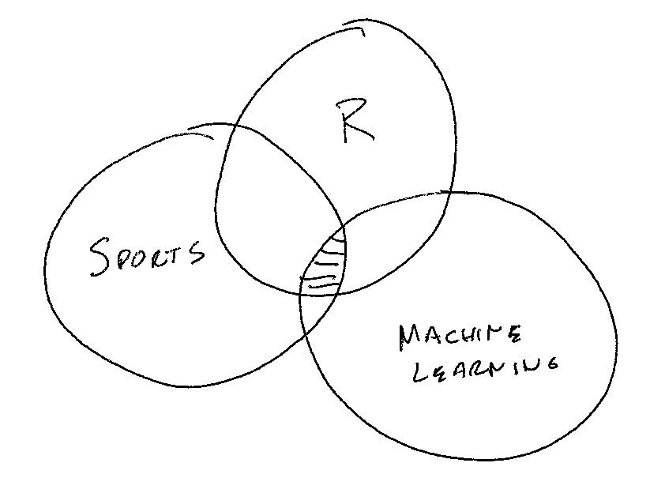
Why do this project?

Slide 7
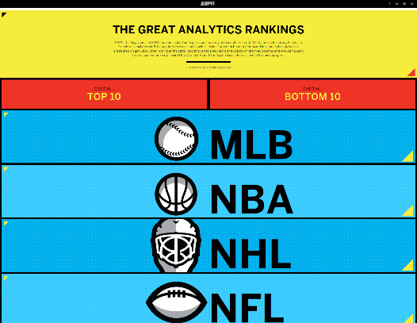
ESPN The Great Analytics Rankings (2015)
http://www.espn.com/espn/feature/story/_/id/12331388/the-great-analytics-rankings

Slide 8
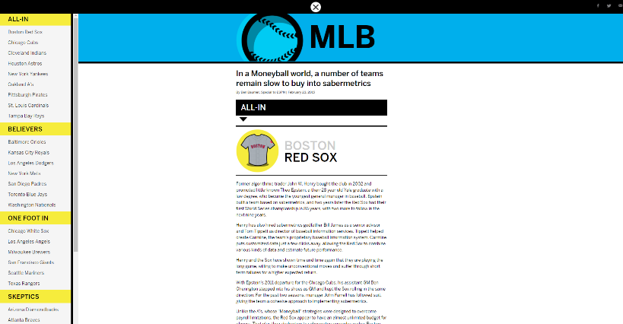
ESPN The Great Analytics Rankings (2015)
http://www.espn.com/espn/feature/story/_/id/12331388/the-great-analytics-rankings

Slide 9
Data
ESPN Analytics Ranking (1-5)
5 – All-in
4 – Believers
3 – One foot in
2 – Skeptics
1 - Nonbelievers
How far did the team go in the playoffs? (1-5)
5 – Champion
4 – Runner up
3 – Loss in third round
2 – Loss in second round
1 – Loss in first round
City size
2010 US Census
Canadian Cities Wikipedia
Salary – spotrac.com

Slide 10
Challenges
Team analytics have changed. 2015 ESPN ranking only performed once.
Salary data issues
Use available cap space for NHL, NFL, NBA
Use total team salary for MLB
Expansion
Las Vegas Golden Knights
Moving
2016 Rams - St. Louis to Los Angeles
2017 Chargers - San Diego to Los Angeles
2020 Raiders - Oakland to Las Vegas
Name Change
Washington Football Team
2020 US Census

Slide 11

https://github.com/ltwalt/espnsports

Slide 12


Question and Answer with Walt Type your questions in the chat section of this session.

Slide 13
M.S. Operations Management at a glance:
100% Online (or live)
In-State Tuition for Everyone!
10 Graduate Course Program (30 hours)
Up to 4 prerequisite classes may be required
Five 8-week Sessions Per Year
Pair Master’s with Graduate Certificate with no extra hours required
No GRE/GMAT required with 3.0 Bachelor's GPA
Total Program Cost is $12,000 to $15,000 (depending on prereqs needed)

Slide 14



Graduate Certificates
Project Management – Designed to provide skills to become better project managers and prepare for PMP Certification
Lean Six Sigma – Learn how to eliminate problems, remove waste and reduce variation to improve operations
Homeland Security – Designed for industry and safety professionals to learn how to mitigate risk

Slide 15

Graduate Certificates
Only 4 Classes!
Obtain as part of your Master’s Degree without taking extra classes
2.5 Undergraduate GPA required for admission
No GRE/GMAT
Classes will double count!
Can also be completed as stand-alone program
Transition to MSOM option with no GRE

Slide 16
Covid-19 Special Announcement:
Effective for Spring, Summer & Fall 2021 terms, at this time we are waiving the GRE for applicants with a 2.5-2.99 undergraduate GPA. Applicants with above a 3.0 GPA is automatically waived for any term.
Once GRE testing centers resume operations, the standard admissions requirements will go back into full effect.

Slide 17
Question and Answer with Walt Type your questions in the chat section of this session.

Slide 18
Next Webinar:
Agile Project Management & Innovative Technology Development
Presented by: Dr. Rocky Gay
Thanks for attending!
For information about our flexible degree program options, email Karin Hickenbotham kahicken@uark.edu or visit operations-management.uark.edu
Registered participants will receive an email with the video link to this webinar.
We hope to see you online next month!

Slide 19
Overview By Sport
Sport | count | MeanESPN | StdESPN
MLB | 30 | 3.5 | 1.3
NBA | 30 | 3.1 | 1.2
NFL | 32 | 2.7 | 1.0
NHL | 31 | 3.4 | 0.9

Slide 20
Local Teams
Sport | City | Team | ESPN | HowFar
MLB | Dallas | Rangers | 3 | 1.7
NBA | Dallas | Mavericks | 5 | 0.5
NFL | Dallas | Cowboys | 4 | 1.0
NHL | Dallas | Stars | 3 | 1.3
MLB | Kansas City | Royals | 4 | 1.5
NFL | Kansas City | Chiefs | 4 | 2.2
NBA | Memphis | Grizzlies | 4 | 0.5

Slide 21
Champions 2014
Sport | Team | City | ESPNRating | PopulationMil
MLB | Giants | San Francisco | 3 | 0.9
NBA | GSWarriors | Oakland | 4 | 0.4
NFL | Patriots | Boston | 4 | 0.6
NHL | Blackhawks | Chicago | 5 | 2.7

Slide 22
Champions 2015
Sport | Team | City | ESPNRating | PopulationMil
MLB | Royals | Kansas City | 4 | 2.2
NBA | Cavaliers | Cleveland | 4 | 0.4
NFL | Broncos | Denver | 2 | 0.6
NHL | Penguins | Pittsburgh | 4 | 0.3

Slide 23
Champions 2016
Sport | Team | City | ESPNRating | PopulationMil
MLB | Cubs | Chicago | 5 | 2.7
NBA | GSWarriors | Oakland | 4 | 0.4
NFL | Patriots | Boston | 4 | 0.6
NHL | Penguins | Pittsburgh | 4 | 0.3

Slide 24
Champions 2017
Sport | Team | City | ESPNRating | PopulationMil
MLB | Astros | Houston | 5 | 2.1
NBA | GSWarriors | Oakland | 4 | 0.4
NFL | Eagles | Philadelphia | 4 | 1.6
NHL | Capitals | Washington | 4 | 6.1

Slide 25
Champions 2018
Sport | Team | City | ESPNRating | PopulationMil
MLB | RedSox | Boston | 5 | 0.6
NBA | Raptors | Toronto | 3 | 2.7
NFL | Patriots | Boston | 4 | 0.6
NHL | Blues | St Louis | 4 | 0.3

Slide 26
Champions 2019
Sport | Team | City | ESPNRating | PopulationMil
MLB | Nationals | Washington | 4 | 6.1
NBA | Lakers | Los Angeles | 1 | 3.8
NFL | Chiefs | Kansas City | 4 | 2.2
NHL | Lightning | Tampa Bay | 4 | 0.3

Slide 27
ESPN Rating
ESPNRating | Count | HowFar | MeanPop | MeanSalary
1 | 10 | 0.2 | 4.3 | 17.1
2 | 27 | 0.8 | 1.8 | 17.4
3 | 34 | 0.7 | 0.9 | 16.5
4 | 37 | 1.4 | 1.7 | 13.9
5 | 15 | 1.2 | 1.7 | 14.7

Slide 28
ESPN Ranking Best Performance
Sport | Team | City | ESPNRating | PopulationMil | HowFar
NBA | GSWarriors | Oakland | 4 | 0.4 | 3.8
NFL | Patriots | Boston | 4 | 0.6 | 3.8
MLB | Dodgers | Los Angeles | 4 | 3.8 | 2.8
NBA | Cavaliers | Cleveland | 4 | 0.4 | 2.8
NHL | Golden Knights | Las Vegas | 5 | 0.6 | 2.7
NHL | Lightning | Tampa Bay | 4 | 0.3 | 2.7
NBA | Raptors | Toronto | 3 | 2.7 | 2.5
NHL | Penguins | Pittsburgh | 4 | 0.3 | 2.3
MLB | Astros | Houston | 5 | 2.1 | 2.3
NFL | Chiefs | Kansas City | 4 | 2.2 | 2.2

Slide 29
ESPN Ranking Worst Performance
Sport | Team | City | ESPNRating | PopulationMil | HowFar
MLB | Pirates | Pittsburgh | 5 | 0.3 | 0.3
MLB | Rays | Tampa Bay | 5 | 0.3 | 0.3
NBA | Mavericks | Dallas | 5 | 1.2 | 0.5
MLB | As | Oakland | 5 | 0.4 | 0.5
NBA | 76ers | Philadelphia | 5 | 1.6 | 0.8
NBA | Spurs | San Antonio | 5 | 1.5 | 1.3
MLB | Indians | Cleveland | 5 | 0.4 | 1.3
NHL | Blackhawks | Chicago | 5 | 2.7 | 1.3
MLB | Yankees | New York | 5 | 8.6 | 1.5
MLB | RedSox | Boston | 5 | 0.6 | 1.5

Slide 30
Los Angeles Team Performance
Sport | Team | ESPN | HowFar
MLB | Angels | 3 | 0.3
MLB | Dodgers | 4 | 2.8
NBA | Clippers | 2 | 1.2
NBA | Lakers | 1 | 0.8
NFL | Chargers | 1 | 0.3
NFL | Rams | 2 | 0.8
NHL | Ducks | 2 | 1.3
NHL | Kings | 4 | 0.3

Slide 31
New York Team Performance
Sport | Team | ESPN | HowFar
MLB | Mets | 4 | 0.8
MLB | Yankees | 5 | 1.5
NBA | Knicks | 1 | 0.2
NBA | Nets | 1 | 0.3
NFL | Giants | 2 | 1.3
NFL | Jets | 1 | 0.8
NHL | Islanders | 4 | 1.3
NHL | Rangers | 2 | 1.7

Slide 32
Small City's Team Performance
Sport | Team | ESPN | HowFar | PopulationMil
NFL | Packers | 3 | 1.8 | 0.1
NHL | Panthers | 3 | 1.3 | 0.1

Slide 33
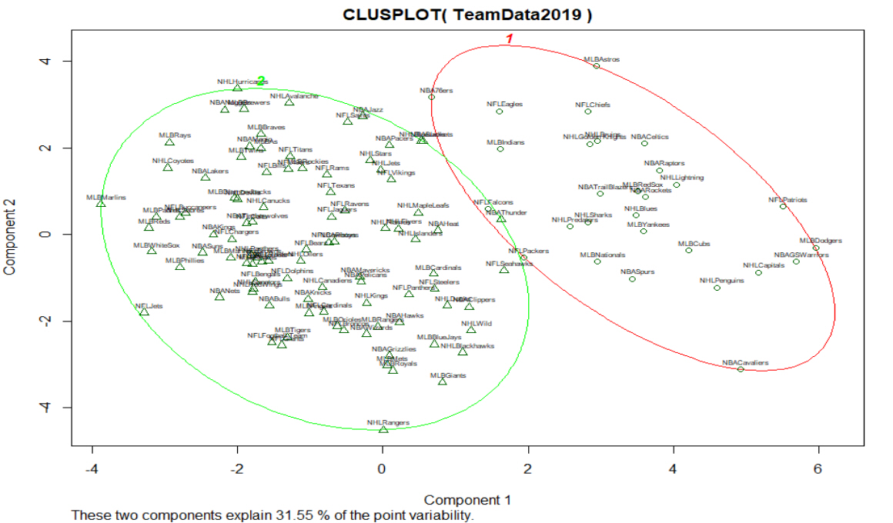
2019 K-Means Clustering Plot

Slide 34
2019 K-Means Clustering Data
Cluster | Teams | MeanX2014HF | MeanX2015HF | MeanX2016HF | MeanX2017HF | MeanX2018HF | MeanX2019HF | MeanPopulation | MeanSalary | MeanESPNRating
1 | 36 | 1.9 | 2.3 | 2.3 | 1.8 | 1.5 | 1.1 | 1.8 | 14.0 | 3.8
2 | 87 | 0.5 | 0.3 | 0.4 | 0.6 | 0.7 | 0.9 | 1.7 | 16.7 | 2.9

Slide 35
